Slide 1
Security Technology Placement

Slide 2
Sensors and collectors
Gather information from across network
Built-in sensors, separate devices
Integrated into switches, routers, servers, firewalls, etc.
Sensors
Intrusion Prevention System
Logs (firewalls, authentication systems, web servers, database transactions, email)
Collectors
Proprietary consoles (IPS, firewall), SIEM controls, syslog servers
Modern SIEMs have correlation engine to aggregate sensor data

Slide 3



Filters and firewalls
Packet filters
Simple data blocks – ignores state
Linux ip command – filter packets in the kernel
Usually placed on a device or server
Firewalls
State-based firewalls
Advanced filtering by address, port, application, content
Usually on external connection of a network
Some placed between internal networks
Internet

Slide 4
Proxy servers
An intermediate server
Client makes request to proxy
Proxy server performs actual request
Proxy then provides response back to the client
Primary benefits
Access control
Caching
URL filtering
Content scanning

Slide 5
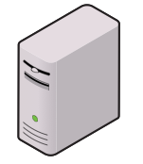

Forward proxy
Protect users from the internet
Internet
User
Proxy
Internal Network

Slide 6

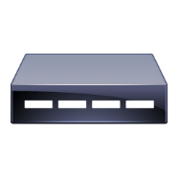

VPN Concentrators
VPN appliances are usually located on the edge of the network
Internet-facing
Sites connect from one site to another across the internet
Remote Site
VPN Concentrator
VPN Concentrator
Company Network

Slide 7
SSL accelerator
The SSL handshake requires some cryptography overhead
Requires a lot of CPU cycles
Client
Web Server
HTTP

Slide 8

SSL accelerator
The SSL handshake requires some cryptography overhead
Requires a lot of CPU cycles
Client
Web Server
HTTPS
HTTP
SSL Accelerator

Slide 9
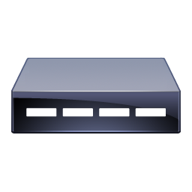
Load balancers
Internet
Manages load across multiple devices
Transparent to user
Placed between the users and the service
Servers can be added and removed
Real-time response to load
Load balancer performs constant checks
No perceived server outages
Fast correction
If server goes down, it’s removed from rotation
Load
Balancer
Server A
Server B
Server C

Slide 10
DDoS mitigation
Resist DDoS attack
Cloud-based
Internet providers
Reverse proxy service
Content delivery network
On-site tools
DDoS filtering in firewall or IPS
Positioned between organization and internet
Where traffic comes into network

Slide 11





Aggregation switches
Core
Distribution
Access

Slide 12
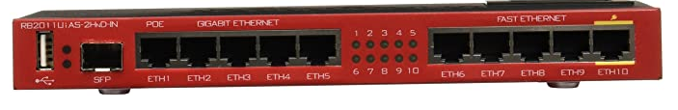
Taps and port mirrors
Mikrotik RouterBOARD RB2011
Intercept network traffic
Send copy to packet capture device
Physical taps
Disconnect the link, put tap inline
Active or passive tap
Port mirror
Port redirection, SPAN (Switched Port ANalyzer)
Software-based tap
Limited functionality but can still get job done

Slide 13
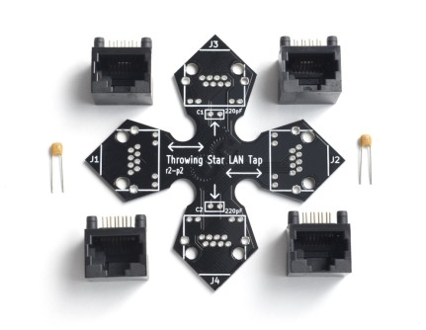
Taps and port mirrors

